Slide 1
Business Buddy
Aplikačný software - AI Chatbot
Matúš Labaj

Slide 2
Obsah
01
02
03
04
05
Motivácia a Ciele
Architektúra a Technológie
Agenti a Funkcionalita
Príklady použitia
Výzvy, prínosy, budúcnosť

Slide 3
01
Motivácia a Ciele

Slide 4
Motivácia
🔹 Prečo vznikol nápad?
Inšpirácia pri osobnej skúsenosti: keď sme s rodičmi chceli začať podnikať, nemali sme právne ani marketingové skúsenosti.
Zistil som, že mnoho začínajúcich podnikateľov čelí rovnakému problému – chýba im prístup k dostupným a presným informáciám.
🔹 Skutočný problém na trhu:
Malé firmy a jednotlivci často:
nemajú právne ani podnikateľské znalosti,
nemajú rozpočet na profesionálne poradenstvo,
nevedia ako urobiť prieskum trhu.
🔹 Cieľová skupina:
Začínajúci podnikatelia, freelanceri, malé firmy, startupy.
Ľudia, ktorí potrebujú poradenstvo, ale nemajú čas alebo zdroje na právnikov či analytikov.

Slide 5
OUR COMPANY
Mercury is the closest planet to the Sun and the smallest one in the Solar System—it’s only a bit larger than the Moon
Your Logo Here

Slide 6
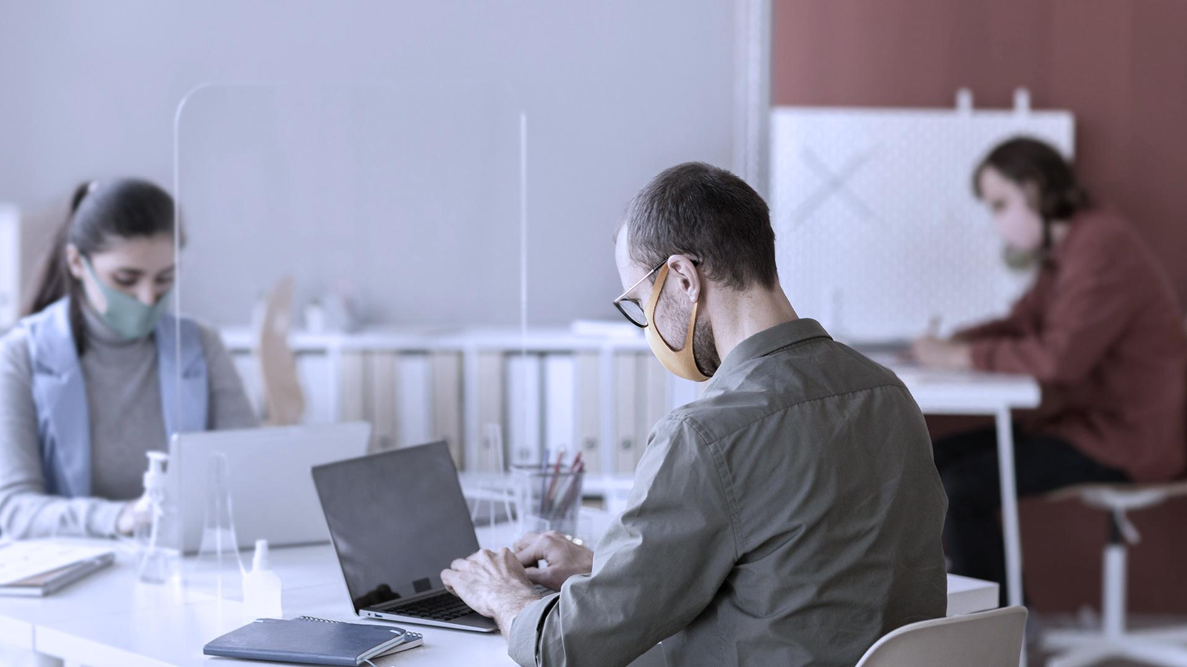
A PICTURE IS WORTH A THOUSAND WORD

Slide 7
REVIEWING CONCEPTS IS A GOOD IDEA
MERCURY
MARS
Mercury is the closest planet to the Sun
Despite being red, Mars is a cold place
VENUS
SATURN
Venus has a
beautiful name
Saturn is the ringed one and a gas giant
JUPITER
NEPTUNE
It’s the biggest planet in the Solar System
Neptune is the farthest planet from the Sun

Slide 8
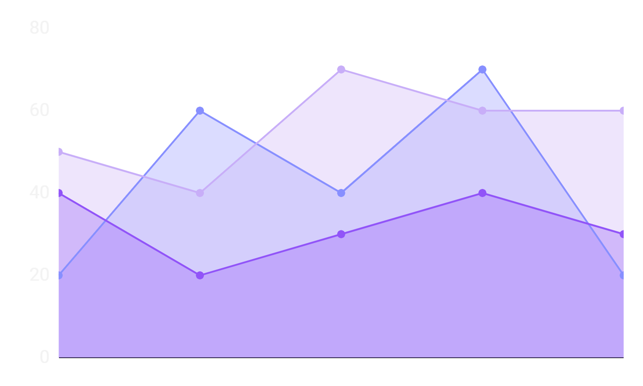
MARKET TRENDS
Despite being red, Mars is a very cold place
Venus has a beautiful name, but it’s terribly hot
Mercury is the closest planet to the Sun
To modify this graph, click on it, follow the link, change the data and paste the resulting graph here, replacing this one

Slide 9
PROBLEM VS SOLUTION
PROBLEM
SOLUTION
Venus has a beautiful name and is the second planet from the Sun. It’s terribly hot!
Mercury is the closest planet to the Sun and also the smallest one in the Solar System

Slide 10
COMPETITORS
MARS
JUPITER
SATURN
Mars is full of iron oxide dust, giving this planet its reddish cast
Jupiter is the biggest one and the fourth-brightest object in the sky
Saturn is a gas giant, composed mostly of hydrogen and helium

Slide 11
02
MARKET ANALYSIS AND COMPETITION

Slide 12
MARKET SIZE
40%
60%
80%
75%
MERCURY
SATURN
MARS
JUPITER
Mercury is the closest planet to the Sun
It is composed of hydrogen and helium
Despite being red, Mars is a cold place
It’s the biggest object in the Solar System

Slide 13
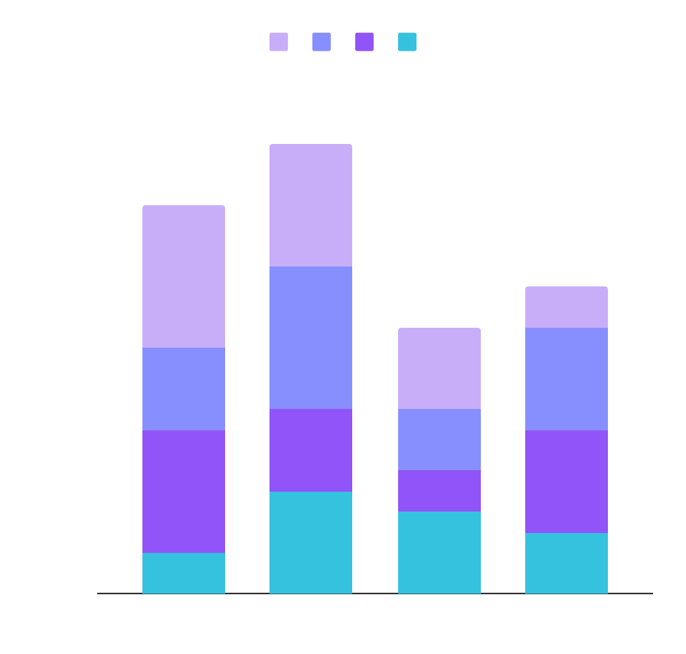
MARKET SHARE
MERCURY
NEPTUNE
Mercury is the closest object to the Sun
Neptune is the farthest planet from the Sun
MARS
JUPITER
Despite being red, Mars is a cold place
Jupiter is the biggest planet of them all
To modify this graph, click on it, follow the link, change the data and paste the new graph here

Slide 14
COMPETITION ANALYSIS
 | JUPITER | MERCURY | VENUS | MARS
COMPETITOR 01
COMPETITOR 02
COMPETITOR 03

Slide 15
03
SALES AND MARKETING PLAN

Slide 16
OUR SERVICES
MERCURY
NEPTUNE
Mercury is the closest planet to the Sun and the smallest one
Neptune is the fourth-largest planet in the Solar System
SATURN
JUPITER
It is the ringed planet. It is composed of hydrogen and helium
Jupiter is a gas giant and the biggest planet in the Solar System

Slide 17
BREAK-EVEN ANALYSIS
BREAK-EVEN POINT
It's the biggest planet in the Solar System
BIG LOSS
LOSS
PROFIT
HIGH PROFIT
Mercury is the closest planet to the Sun
Despite being red, Mars is a very cold place
It's composed of hydrogen and of helium
Neptune is the farthest planet from the Sun

Slide 18
OUR PLANS
BASIC | PRO | PREMIUM
Despite being red, Mars is a very cold place | Venus has a beautiful name, but it’s terribly hot | Mercury is the closest planet to the Sun
$50 | $75 | $95

Slide 19
SALES AND DISTRIBUTION
CHANNEL 1
Mercury is the closest planet to the Sun and the smallest one
CHANNEL 2
It is the ringed planet. It is composed of hydrogen and helium
CHANNEL 3
Jupiter is a gas giant and the biggest object in the Solar System
CHANNEL 4
Despite being red, Mars is actually a very cold place

Slide 20
ADVERTISING AND PROMOTION
CHANNEL 1
ADVERTISING
It’s the farthest planet from the Sun
CHANNEL 2
PR
Venus is the second planet from the Sun
CHANNEL 3
ONLINE
It’s only a bit larger than the Moon

Slide 21
04
MANAGEMENT PLAN

Slide 22





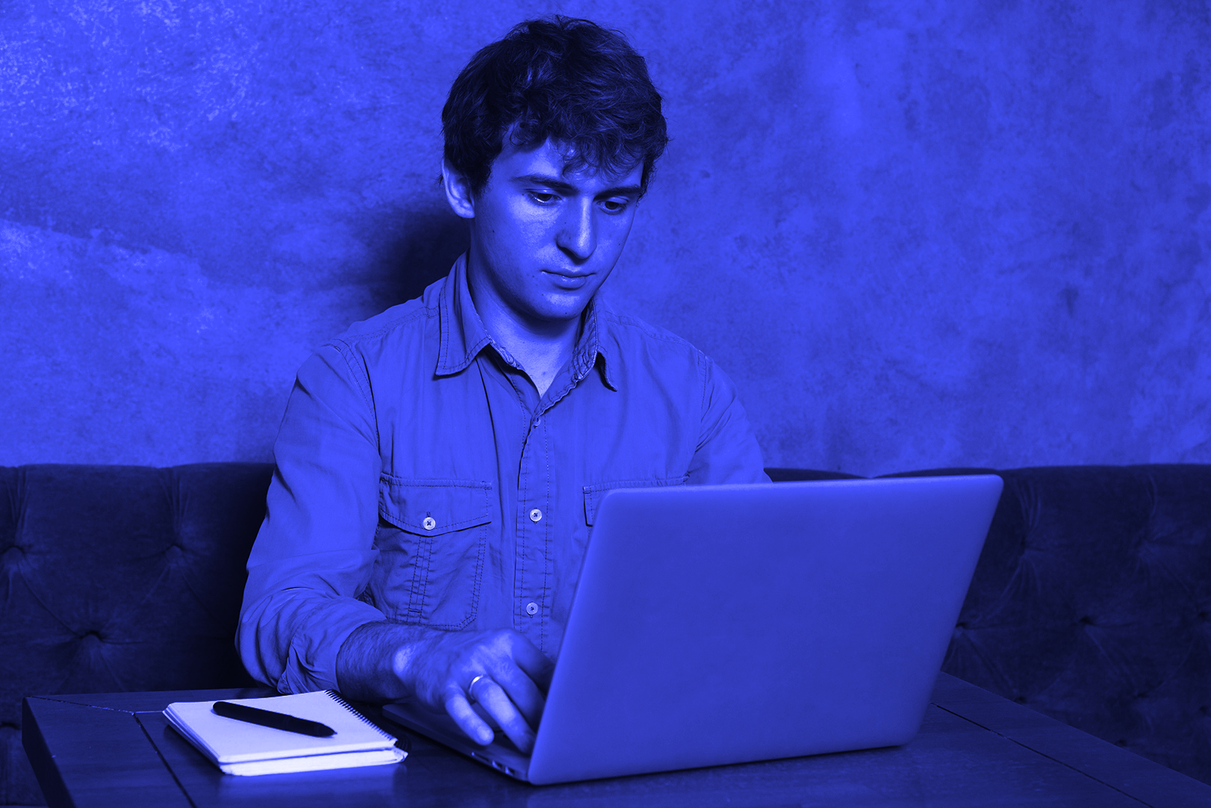
OUR TEAM
SARAH LEE
AVA SMITH
STEPHEN JAY
You can replace the image on the screen with your own
You can replace the image on the screen with your own
You can replace the image on the screen with your own

Slide 23
ORGANIZATIONAL CHART
CEO
TEAM 1
TEAM 2
TEAM 3

Slide 24
OUR PARTNERS
JUPITER
It’s the biggest planet in the Solar System
VENUS
Venus is terribly hot, even hotter than Mercury
MERCURY
Mercury is the closest planet to the Sun
MARS
Despite being red, Mars is now a very cold place
NEPTUNE
Neptune is the farthest planet from the Sun

Slide 25
05
OPERATING PLAN

Slide 26
OUR PROCESS
DAY 2
DAY 4
DAY 1
DAY 3
DAY 5
Despite being red, Mars is actually a very cold place
Jupiter is the biggest planet in the Solar System
Venus is terribly hot, even hotter than Mercury
Mercury is the closest planet to the Sun
Neptune is the farthest planet from the Sun

Slide 27
06
FINANCIAL PLAN

Slide 28
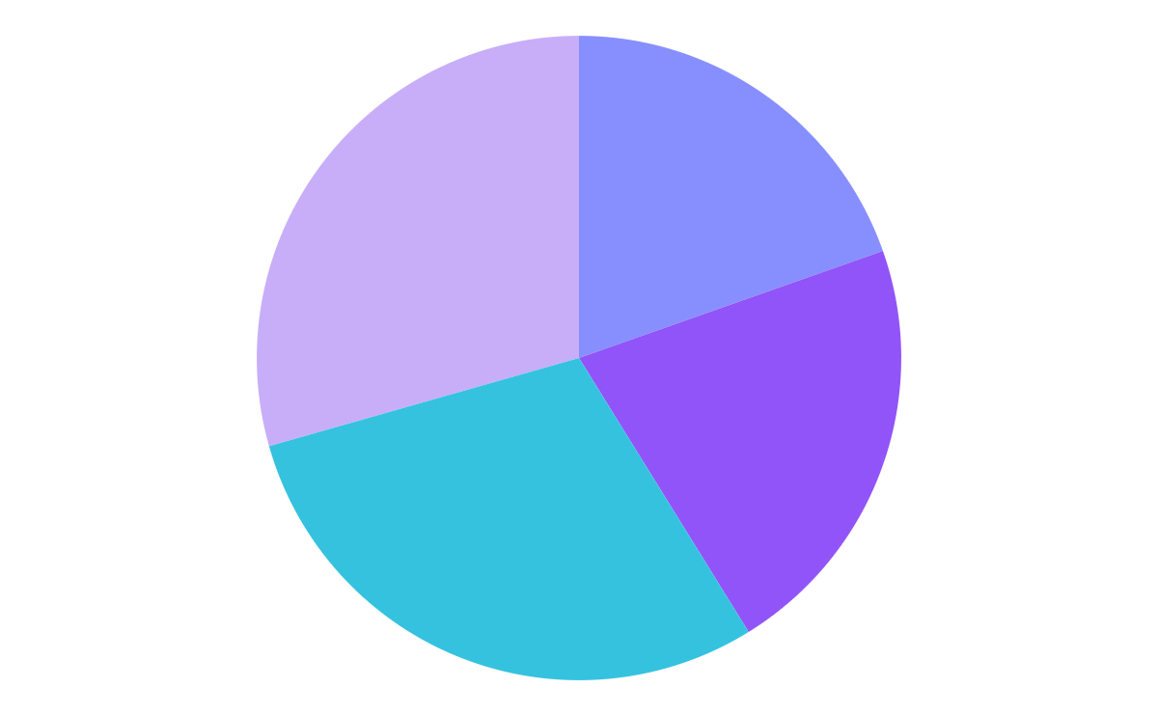
PREDICTED GROWTH
NEPTUNE
JUPITER
Neptune is the farthest planet from the Sun
It’s the biggest planet in the Solar System
MARS
MERCURY
Despite being red, Mars is a very cold place
Mercury is the closest planet to the Sun
To modify this graph, click on it, follow the link, change the data and paste the resulting graph here, replacing this one

Slide 29
BALANCE SHEET
1M
300K
700K
ASSETS
What the company owns
LIABILITIES
What the company owes
EQUITY
Difference between both

